Slide 1
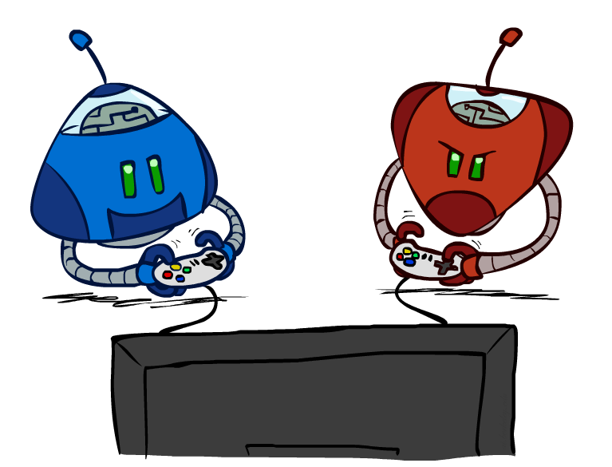
CSE 511A: Introduction to Artificial Intelligence
Adversarial Search
Instructor: Roman Garnett
Washington University in St. Louis
[These slides were created by Dan Klein and Pieter Abbeel for CS188 Intro to AI at UC Berkeley. All CS188 materials are available at http://ai.berkeley.edu.]
Notes:
Please retain proper attribution, including the reference to ai.berkeley.edu. Thanks!

Slide 2
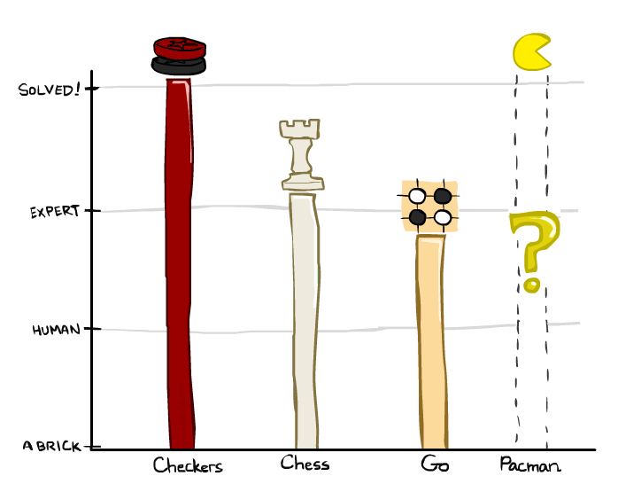
Game Playing State-of-the-Art
Checkers: 1950: First computer player. 1994: First computer champion: Chinook ended 40-year-reign of human champion Marion Tinsley using complete 8-piece endgame. 2007: Checkers solved!
Chess: 1997: Deep Blue defeats human champion Gary Kasparov in a six-game match. Deep Blue examined 200M positions per second, used very sophisticated evaluation and undisclosed methods for extending some lines of search up to 40 ply. Current programs are even better, if less historic.
Go: Human champions are now starting to be challenged by machines! AlphaGo beat Lee Sedol in landmark match. In go, b > 300! Classic programs use pattern knowledge bases, but big recent advances use Monte Carlo (randomized) expansion methods with “deep learning.”
Pacman

Slide 3
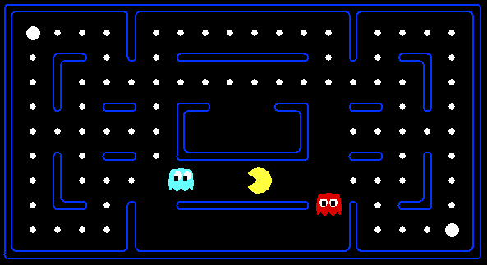
Behavior from Computation
[Demo: mystery pacman (L6D1)]
Notes:
Point of the class: general-purpose code to adapt and react appropriately in new situations.
What is pacman doing?
Avoid rules! Fragile, lots of code, may not generalize.

Slide 4

Video of Demo Mystery Pacman

Slide 5
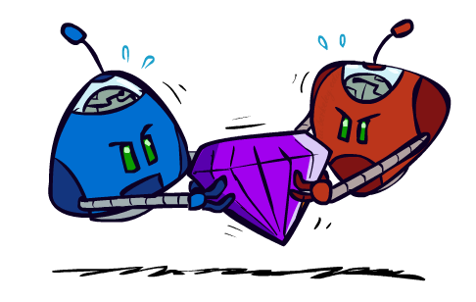
Adversarial Games
Notes:
Search but you’re not the only person in the environment

Slide 6
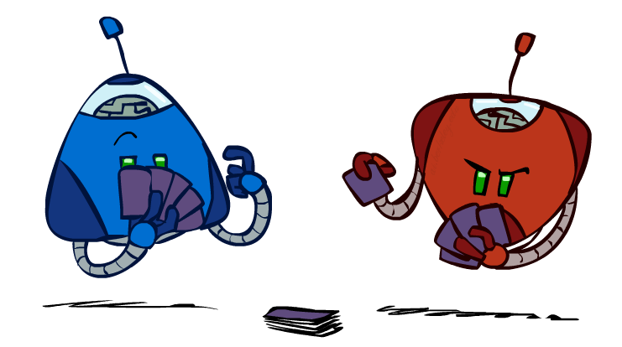
Types of Games
Many different kinds of games!
Axes:
Deterministic or stochastic?
One, two, or more players?
Zero sum?
Perfect information (can you see the state)?
Want algorithms for calculating a strategy (policy) which recommends a move from each state
Notes:
Only certain types of games: no poker (imperfect information) no starcraft (also imperfect information), only two players, zero-sum, deterministic.
Different from search: can’t make a plan. Instead, policy tells you to do in each state: input state, output action (move).

Slide 7
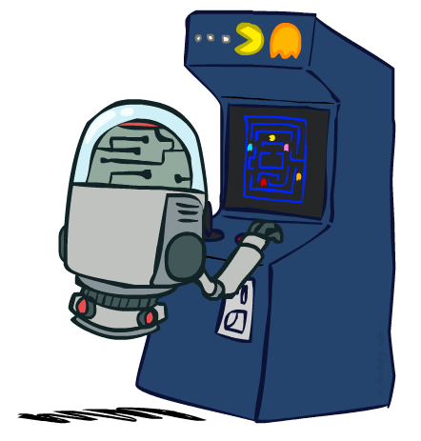
Deterministic Games
Many possible formalizations, one is:
States: S (start at s₀)
Players: P={1...N} (usually take turns)
Actions: A (may depend on player / state)
Transition Function: SxA → S
Terminal Test: S → {t,f}
Terminal Utilities: SxP → R
Solution for a player is a policy: S → A
Notes:
Lots of ways to formalize games.
Transition function is like successor function.
Terminal test is like the goal test.
Terminal utilities tells us how good each possible ending state is.

Slide 8
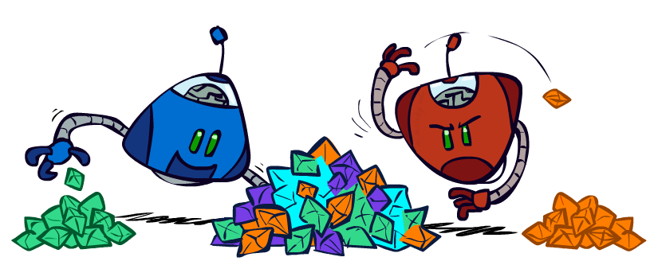
Zero-Sum Games
Zero-Sum Games
Agents have opposite utilities (values on outcomes)
Lets us think of a single value that one maximizes and the other minimizes
Adversarial, pure competition
General Games
Agents have independent utilities (values on outcomes)
Cooperation, indifference, competition, and more are all possible
More later on non-zero-sum games
Notes:
Zero-sum games: if one player likes an ending state, the other hates it.
We don’t have to consider the players separately. We can just have one function: red player maximizes, blue player minimizes.
Not quite true in general. People could have different utilities, which could agree or disagree, which could lead to all kinds of behavior.

Slide 9

Adversarial Search
Notes:
Think about consequences of actions. Instead of only thinking about your actions, you have to imagine what the other player will do as well.

Slide 10
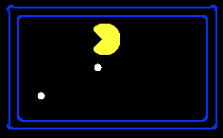
Single-Agent Trees
8
2
0
…
2
6
…
4
6
Notes:
Computationally? Imagine a search tree. Add a score to outcomes. In single-player case, can pick out any one you want and plan for it.

Slide 11
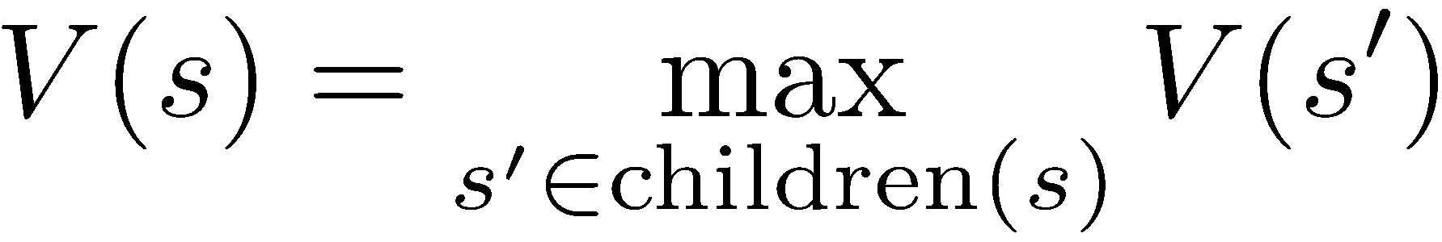
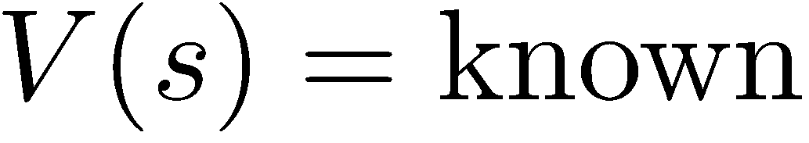
Value of a State
Value of a state: The best achievable outcome (utility) from that state
Non-Terminal States:
8
2
0
…
2
6
…
4
6
Terminal States:

Slide 12

Adversarial Game Trees
-20
-8
…
-18
-5
…
-10
+4
-20
+8
Notes:
Same as before but interweave other player’s possible actions. Only difference is who chooses what happens. Can’t just take the maximum anymore.

Slide 13
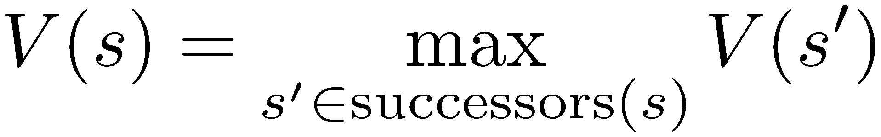
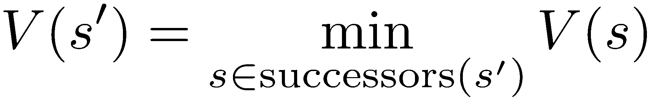
Minimax Values
States Under Agent’s Control:
States Under Opponent’s Control:
-8
-5
-10
+8
Terminal States:
Notes:
What is value? Now it’s the best thing we can achieve, allowing the adversary to play well as well. Assume the adversary plays to hurt you!

Slide 14

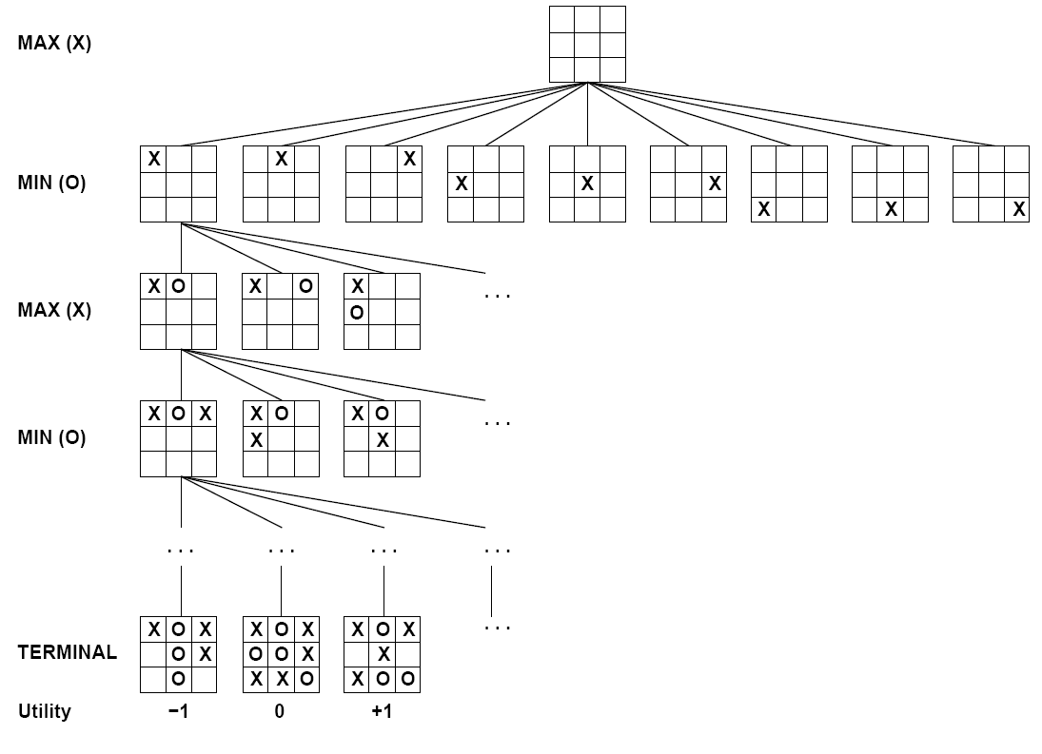

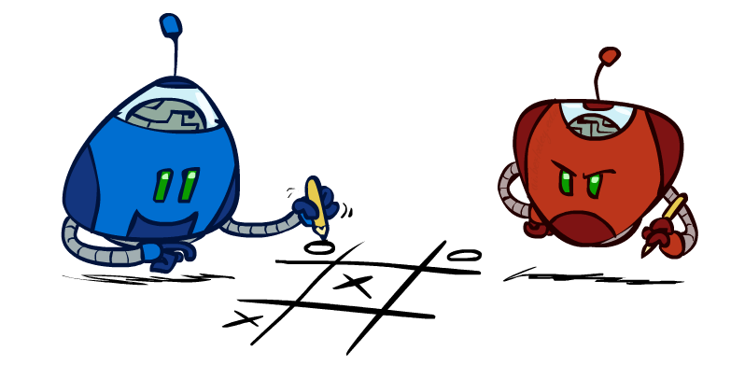
Tic-Tac-Toe Game Tree
Notes:
Can do the computation, value of root is zero (you probably know this from experience). No matter what, we know the value of the root is one of these three values: -1, 0, +1. No averaging or anything.

Slide 15
Adversarial Search (Minimax)
Deterministic, zero-sum games:
Tic-tac-toe, chess, checkers
One player maximizes result
The other minimizes result
Minimax search:
A state-space search tree
Players alternate turns
Compute each node’s minimax value: the best achievable utility against a rational (optimal) adversary
Minimax values: computed recursively
5
max
2
5
min
8
2
5
6
Terminal values: part of the game
Notes:
Pretty simple algorithm: pick an action with highest minimax value. Compute them recursively.

Slide 16
Minimax Implementation
def max-value(state):
initialize v = -∞
for each successor of state:
v = max(v, min-value(successor))
return v
def min-value(state):
initialize v = +∞
for each successor of state:
v = min(v, max-value(successor))
return v
Notes:
Pretty simple implementation. Mutual recursion.

Slide 17
Minimax Implementation (Dispatch)
def value(state):
if the state is a terminal state: return the state’s utility
if the next agent is MAX: return max-value(state)
if the next agent is MIN: return min-value(state)
def max-value(state):
initialize v = -∞
for each successor of state:
v = max(v, value(successor))
return v
def min-value(state):
initialize v = +∞
for each successor of state:
v = min(v, value(successor))
return v
Notes:
Can be useful for programming: let the state have a value and compute it in various ways. Pick an order for two reasons: sequential processor and pruning

Slide 18
Minimax Example
3
12
8
2
4
6
14
5
2

Slide 19
Minimax Efficiency
How efficient is minimax?
Just like (exhaustive) DFS
Time: O(b^{m})
Space: O(bm)
Example: For chess, b ≈ 35, m ≈ 100
Exact solution is completely infeasible
But, do we need to explore the whole tree?
Notes:
Basically like DFS.

Slide 20
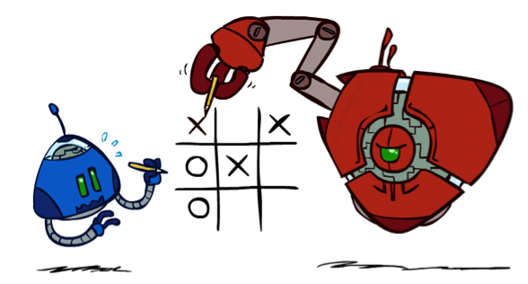
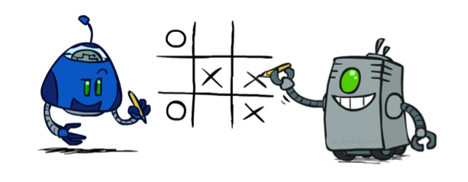
Minimax Properties
max
min
10
10
9
100
Optimal against a perfect player. Otherwise?
[Demo: min vs exp (L6D2, L6D3)]

Slide 21
Video of Demo Min vs. Exp (Min)

Slide 22
Video of Demo Min vs. Exp (Exp)

Slide 23

Resource Limits

Slide 24
Resource Limits
Problem: In realistic games, cannot search to leaves!
Solution: Depth-limited search
Instead, search only to a limited depth in the tree
Replace terminal utilities with an evaluation function for non-terminal positions
Example:
Suppose we have 100 seconds, can explore 10K nodes / sec
So can check 1M nodes per move
α-β reaches about depth 8 – decent chess program
Guarantee of optimal play is gone
More plies makes a BIG difference
Use iterative deepening for an anytime algorithm
max
4
-2
4
min
-1
-2
4
9
?
?
?
?

Slide 25
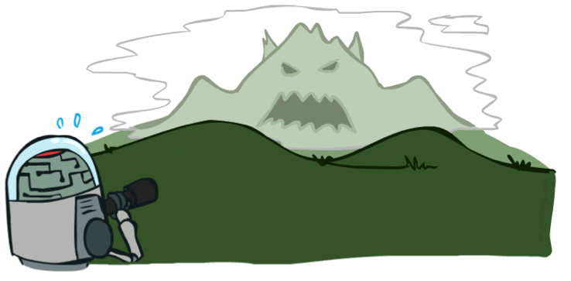

Depth Matters
Evaluation functions are always imperfect
The deeper in the tree the evaluation function is buried, the less the quality of the evaluation function matters
An important example of the tradeoff between complexity of features and complexity of computation
[Demo: depth limited (L6D4, L6D5)]

Slide 26
Video of Demo Limited Depth (2)

Slide 27
Video of Demo Limited Depth (10)

Slide 28
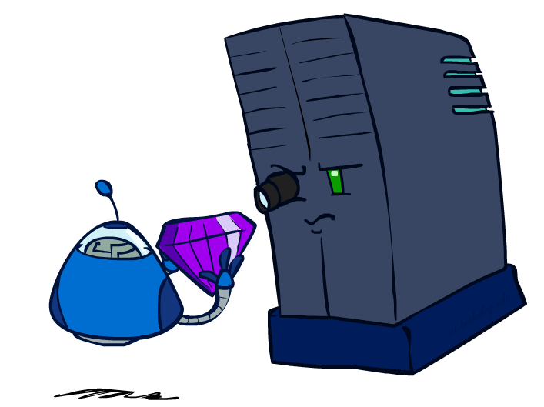
Evaluation Functions

Slide 29
Evaluation Functions
Evaluation functions score non-terminals in depth-limited search
Ideal function: returns the actual minimax value of the position
In practice: typically weighted linear sum of features:
e.g. f₁(s) = (num white queens – num black queens), etc.

Slide 30




Evaluation for Pacman
[Demo: thrashing d=2, thrashing d=2 (fixed evaluation function), smart ghosts coordinate (L6D6,7,8,10)]

Slide 31
Video of Demo Thrashing (d=2)

Slide 32
Why Pacman Starves
A danger of replanning agents!
He knows his score will go up by eating the dot now (west, east)
He knows his score will go up just as much by eating the dot later (east, west)
There are no point-scoring opportunities after eating the dot (within the horizon, two here)
Therefore, waiting seems just as good as eating: he may go east, then back west in the next round of replanning!

Slide 33
Video of Demo Thrashing -- Fixed (d=2)

Slide 34
Video of Demo Smart Ghosts (Coordination)
Notes:
Two agents treated as min players gives coordination between agents!

Slide 35
Video of Demo Smart Ghosts (Coordination) – Zoomed In

Slide 36
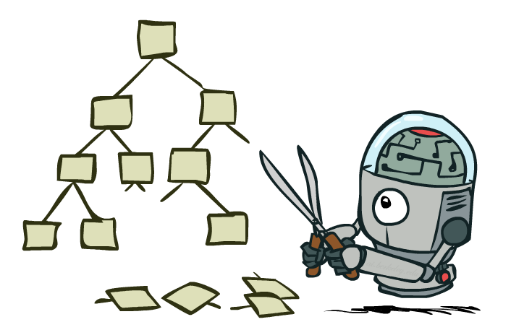
Game Tree Pruning

Slide 37
Minimax Example
3
12
8
2
4
6
14
5
2

Slide 38
Minimax Pruning
3
12
8
2
14
5
2

Slide 39
Alpha-Beta Pruning
General configuration (MIN version)
We’re computing the MIN-VALUE at some node n
We’re looping over n’s children
n’s estimate of the childrens’ min is dropping
Who cares about n’s value? MAX
Let a be the best value that MAX can get at any choice point along the current path from the root
If n becomes worse than a, MAX will avoid it, so we can stop considering n’s other children (it’s already bad enough that it won’t be played)
MAX version is symmetric
MAX
MIN
a
MAX
MIN
n

Slide 40
Alpha-Beta Implementation
α: MAX’s best option on path to root
β: MIN’s best option on path to root
def max-value(state, α, β):
initialize v = -∞
for each successor of state:
v = max(v, value(successor, α, β))
if v ≥ β return v
α = max(α, v)
return v
def min-value(state , α, β):
initialize v = +∞
for each successor of state:
v = min(v, value(successor, α, β))
if v ≤ α return v
β = min(β, v)
return v
Notes:
Pick an order for two reasons: sequential processor and pruning

Slide 41
Alpha-Beta Pruning Properties
This pruning has no effect on minimax value computed for the root!
Values of intermediate nodes might be wrong
Important: children of the root may have the wrong value
So the most naïve version won’t let you do action selection
Good child ordering improves effectiveness of pruning
With “perfect ordering”:
Time complexity drops to O(b^{m/2})
Doubles solvable depth!
Full search of, e.g. chess, is still hopeless…
This is a simple example of metareasoning (computing about what to compute)
max
min
10
10
0

Slide 42
Next Time: Uncertainty!

Slide 43
Iterative Deepening
Iterative deepening uses DFS as a subroutine:
Do a DFS which only searches for paths of length 1 or less. (DFS gives up on any path of length 2)
If “1” failed, do a DFS which only searches paths of length 2 or less.
If “2” failed, do a DFS which only searches paths of length 3 or less.
….and so on.
Why do we want to do this for multiplayer games?
Note: wrongness of eval functions matters less and less the deeper the search goes!
b
…

